Slide 1
Big Data Tool-HIVE
Sawon Bhattacharya
MSc Computer Science
1st year(Batch 1)
19370045

Slide 2
?WHAT?
Apache Hive is a Data Warehousing package built on top of Hadoop and is used for data analysis.
It is used for managing and querying structured data.
Hive allows traditional map/reduce programmers to plug in their custom mappers and reducers.
The popular feature of Hive is that there is no need to learn Java.

Slide 3
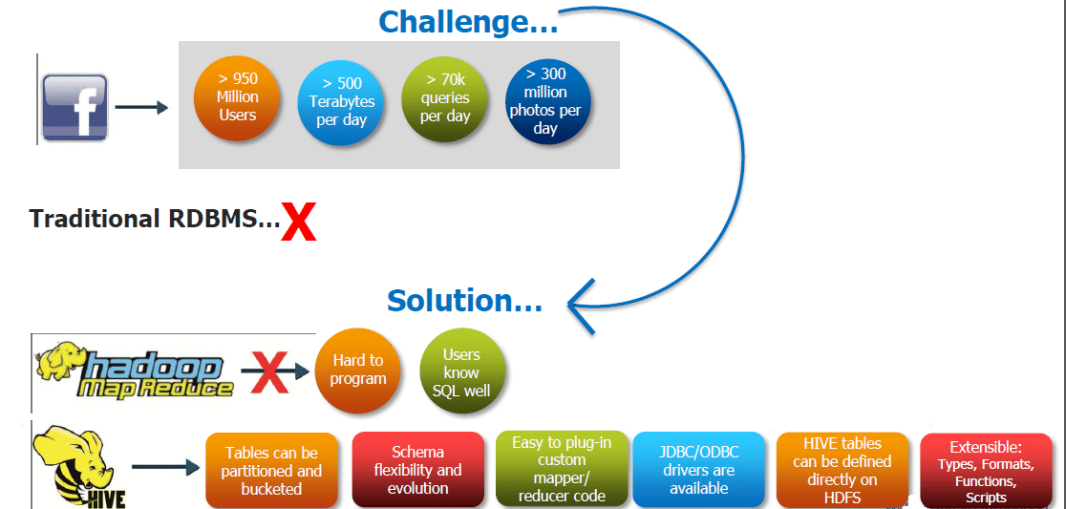
?WHY?

Slide 4
?WHEN?
Hive was developed by the Data Infrastructure Team at Facebook.
Hive is very popular with all the users internally at Facebook and is being used to run thousands of jobs on the cluster with hundreds of users, for a wide variety of applications.
Hive-Hadoop cluster at Facebook stores more than 2PB of raw data and regularly loads 15 TB of data on a daily basis.

Slide 5
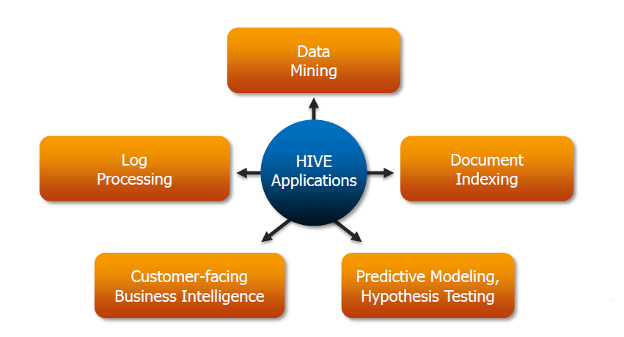
?WHERE?

Slide 6
FEATURES
Allows programmers to plug in custom Mappers and Reducers.
Has Data Warehouse infrastructure.
Provides tools to enable easy data ETL.
Defines SQL-like query language called HQL.
Faster Batch Processing.

Slide 7
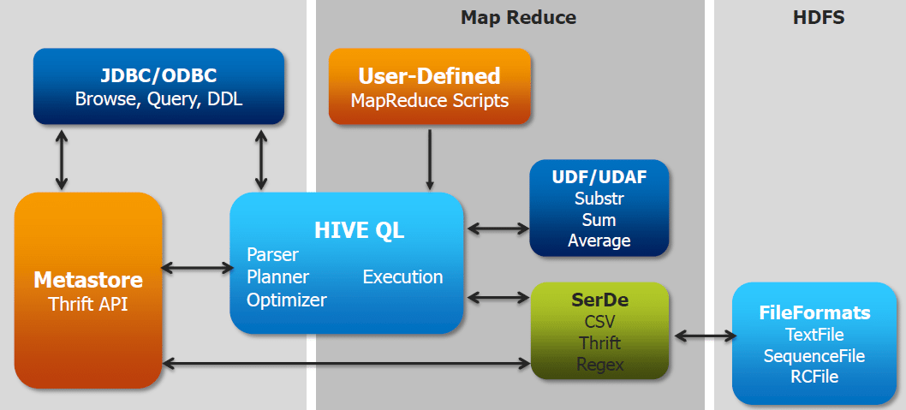
Architecture

Slide 8
..Continuation
Metastore – To store the metadata.
JDBC/ODBC – Query Compiler and Execution Engine to convert SQL queries to a sequence of MapReduce.
SerDe and Object Inspectors – For data formats and types.
UDF/UDAF – For User Defined Functions.
Clients – Similar to MySQL command line and a web UI.

Slide 9
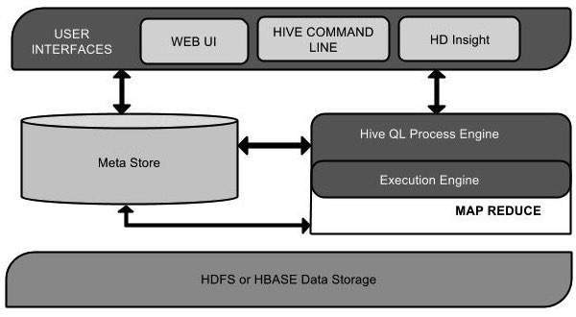
Components

Slide 10
…Continuation
Unit Name | Operation
User Interface | Hive is a data warehouse infrastructure software that can create interaction between user and HDFS. The user interfaces that Hive supports are Hive Web UI, Hive command line, and Hive HD Insight (In Windows server).
Meta Store | Hive chooses respective database servers to store the schema or Metadata of tables, databases, columns in a table, their data types, and HDFS mapping.
HiveQL Process Engine | HiveQL is similar to SQL for querying on schema info on the Metastore. It is one of the replacements of traditional approach for MapReduce program. Instead of writing MapReduce program in Java, we can write a query for MapReduce job and process it.
Execution Engine | The conjunction part of HiveQL process Engine and MapReduce is Hive Execution Engine. Execution engine processes the query and generates results as same as MapReduce results. It uses the flavor of MapReduce.
HDFS or HBASE | Hadoop distributed file system or HBASE are the data storage techniques to store data into file system.

Slide 11
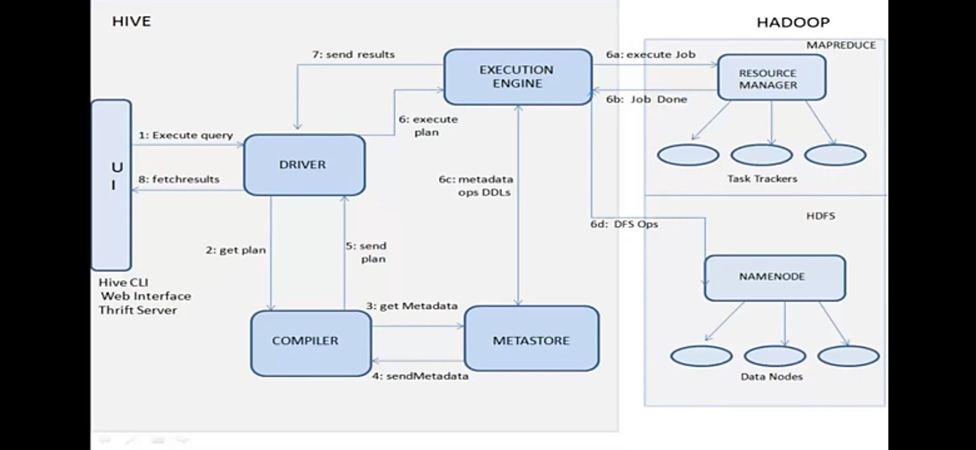
Working of Hive

Slide 12
…Continuation
Execute Query: The Hive interface such as Command Line or Web UI sends query to Driver (any database driver such as JDBC, ODBC, etc.) to execute.
Get Plan: The driver takes the help of query compiler that parses the query to check the syntax and query plan or the requirement of query.
Get Metadata: The compiler sends metadata request to Metastore (any database).
Send Metadata: Metastore sends metadata as a response to the compiler.

Slide 13
…Continuation
Send Plan The compiler checks the requirement and resends the plan to the driver. Up to here, the parsing and compiling of a query is complete.
Execute Plan The driver sends the execute plan to the execution engine.
Execute Job Internally, the process of execution job is a MapReduce job. The execution engine sends the job to JobTracker, which is in Name node and it assigns this job to TaskTracker, which is in Data node. Here, the query executes MapReduce job.

Slide 14
…Continuation
Metadata Ops Meanwhile in execution, the execution engine can execute metadata operations with Metastore.
Fetch Result The execution engine receives the results from Data nodes.
Send Results The execution engine sends those resultant values to the driver.
Send Results The driver sends the results to Hive Interfaces.

Slide 15
PIG vs HIVE
Let’s talk about similarities :
Pig and Hive are the two key components of the Hadoop ecosystem.
Pig Hadoop and Hive Hadoop have a similar goal- they are tools that ease the complexity of writing complex java MapReduce programs.
If we take a look at diagrammatic representation of the Hadoop ecosystem, HIVE and PIG components cover the same verticals and this certainly raises the question, which one is better? It’s Pig vs Hive (Yahoo vs Facebook).

Slide 16
…Continuation
HIVE
PIG
Declarative SQLish Language
For creating reports
Mainly used by Data Analysts
Operates on the server side of a cluster.
Makes use of exact variation of dedicated SQL DDL language by defining tables beforehand.
Directly leverages SQL and is easy to learn for database experts.
Hive does not support it.
Procedural Data Flow Language
For Programming
Mainly used by Researchers and Programmers
Operates on the client side of a cluster.
Does not have a dedicated metadata database.
Pig is SQL like but varies to a great extent.
Pig supports Avro file format.

Slide 17
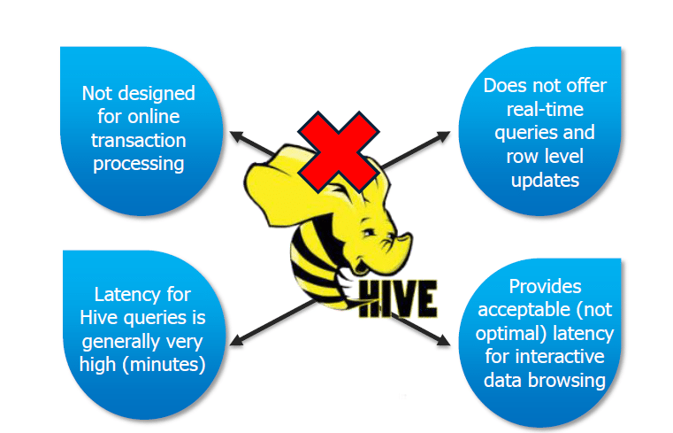
LIMITATIONS

Slide 18
References
https://www.edureka.co/blog/hive-tutorial/
https://www.cloudera.com/products/open-source/apache-hadoop/apache-hive.html
https://www.tutorialspoint.com/hive/hive_introduction.htm
https://www.dezyre.com/article/difference-between-pig-and-hive-the-two-key-components-of-hadoop-ecosystem/79

Slide 19
THANK YOU

